Slide 1
Hypothesis Testing Procedures
CHAPTER 7

Slide 2
Learning Objectives (1 of 3)
Define null and research hypothesis, test statistic, level of significance, and decision rule
Distinguish between Type I and Type II errors and discuss the implications of each
Explain the difference between one- and two-sided tests of hypothesis
Estimate and interpret p-values

Slide 3
Learning Objectives (2 of 3)
Explain the relationship between confidence interval estimates and p-values in drawing inferences
Perform analysis of variance by hand
Appropriately interpret the results of analysis of variance tests
Distinguish between one- and two-factor analysis of variance tests

Slide 4
Learning Objectives (3 of 3)
Perform chi-square tests by hand
Appropriately interpret the results of chi-square tests
Identify the appropriate hypothesis testing procedures based on type of outcome variable and number of samples

Slide 5
Hypothesis Testing
Research hypothesis is generated about unknown population parameter.
Sample data are analyzed and determined to support or refute the research hypothesis.

Slide 6
Hypothesis Testing Procedures Step 1
Null hypothesis (H₀):
No difference, no change
Research hypothesis (H₁):
What investigator believes to be true

Slide 7
Hypothesis Testing Procedures Step 2
Collect sample data and determine whether sample data support research hypothesis or not.
For example, in test for μ, evaluate .

Slide 8
Hypothesis Testing Procedures Step 3
Set up decision rule to decide when to believe null versus research hypothesis.
Depends on level of significance, α = P(Reject H₀|H₀ is true)

Slide 9
Hypothesis Testing Procedures Steps 4 and 5
Summarize sample information in test statistic (e.g., Z value).
Draw conclusion by comparing test statistic to decision rule.
Provide final assessment as to whether H₁ is likely true given the observed data.

Slide 10
p-values
p-values represent the exact significance of the data.
Estimate p-values when rejecting H₀ to summarize significance of the data (can approximate with statistical tables, can get exact value with statistical computing package).
p-value is the smallest α where we still reject H₀.

Slide 11
Hypothesis Testing Procedures
Set up null and research hypotheses, select α.
Select test statistic.
Set up decision rule.
Compute test statistic.
Draw conclusion and summarize significance.

Slide 12
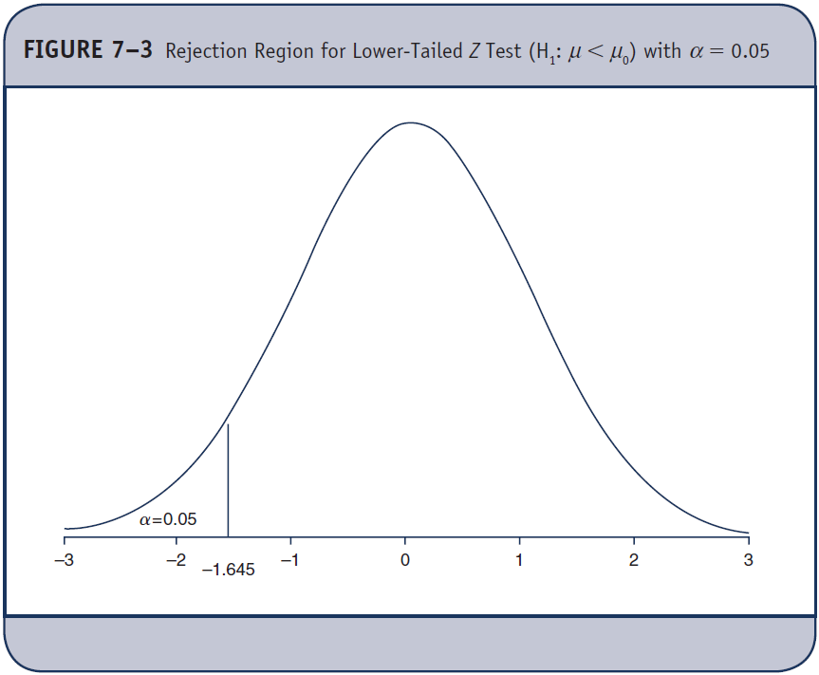
Errors in Hypothesis Tests

Slide 13
Hypothesis Testing for μ
Continuous outcome
One sample
H₀: μ = μ₀
H₁: μ > μ₀, μ < μ₀, μ ≠ μ₀
Test statistic:
n ≥ 30 (Find critical
value in Table 1C,
n < 30 Table 2, df = n – 1)

Slide 14
Example 7.2. Hypothesis Testing for μ (1 of 4)
The National Center for Health Statistics (NCHS) reports the mean total cholesterol for adults is 203. Is the mean total cholesterol in Framingham Heart Study participants significantly different?
In 3310 participants the mean is 200.3 with a standard deviation of 36.8.

Slide 15
Example 7.2. Hypothesis Testing for μ (2 of 4)
1. H₀: μ = 203
H₁: μ ≠ 203 α = 0.05
2. Test statistic:
3. Decision rule:
Reject H₀ if z ≥ 1.96 or if z ≤ –1.96

Slide 16
Example 7.2. Hypothesis Testing for μ (3 of 4)
4. Compute test statistic:
Conclusion. Reject H₀ because –4.22 < –1.96. We have statistically significant evidence at α = 0.05 to show that the mean total cholesterol is different in Framingham Heart Study participants.

Slide 17
Example 7.2. Hypothesis Testing for μ (4 of 4)
Significance of the findings: Z = –4.22
Table 1C. Critical Values for Two-Sided Tests
α Z
0.20 1.282
0.10 1.645
0.05 1.960
0.010 2.576
0.001 3.291
0.0001 3.819 p < 0.0001

Slide 18
New Scenario
Outcome is dichotomous (p = population proportion).
Result of surgery (success, failure)
Cancer remission (yes/no)
One study sample
Data
On each participant, measure outcome (yes/no)
n, x = number of positive responses,

Slide 19
Hypothesis Testing for p
Dichotomous outcome
One sample
H₀: p = p₀
H₁: p > p₀, p < p₀, p ≠ p₀
Test statistic:
(Find critical value in Table 1C)

Slide 20
Example 7.4. Hypothesis Testing for p (1 of 3)
The NCHS reports that the prevalence of cigarette smoking among adults in 2002 is 21.1%. Is the prevalence of smoking lower among participants in the Framingham Heart Study?
In 3536 participants, 482 reported smoking.

Slide 21
Example 7.4. Hypothesis Testing for p (2 of 3)
1. H₀: p = 0.211
H₁: p < 0.211 α = 0.05
Test statistic:
3. Decision rule:
Reject H₀ if z ≤ –1.645

Slide 22
Example 7.4. Hypothesis Testing for p (3 of 3)
4. Compute test statistic:
5. Conclusion. Reject H₀ because –10.93 < –1.645. We have statistically significant evidence at α = 0.05 to show that the prevalence of smoking is lower among the Framingham Heart Study participants. (p < 0.0001)

Slide 23
Hypothesis Testing for Categorical and Ordinal Outcomes*
Categorical or ordinal outcome
One sample
H₀: p₁ = p₁₀, p₂ = p₂₀,…,p_{k} = p_{k0}
H₁: H₀ is false
Test statistic:
(Find critical value in Table 3, df = k – 1)
* χ² goodness-of-fit test

Slide 24
Chi-Square Tests
χ² tests are based on the agreement between expected (under H₀) and observed (sample) frequencies.
Test statistic:

Slide 25
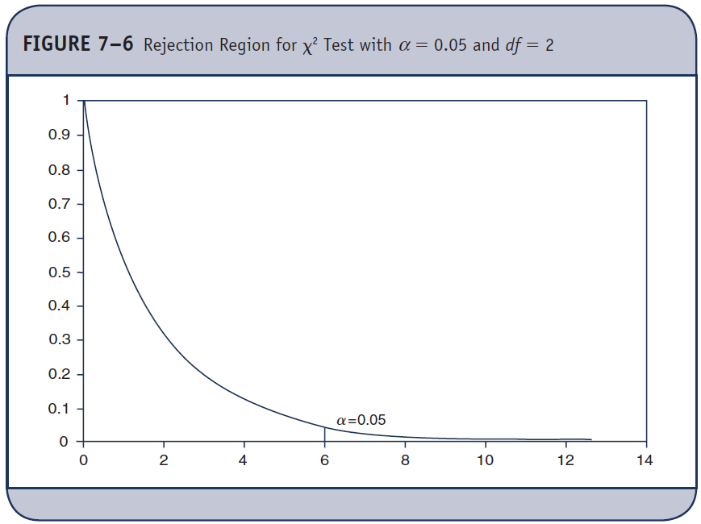
Chi-Square Distribution
If H₀ is true χ² will be close to 0; if H₀ is false, χ² will be large.
Reject H₀ if χ² > Critical value from Table 3

Slide 26
Example 7.6. χ² Goodness-of-Fit Test (1 of 4)
A university survey reveals that 60% of students get no regular exercise, 25% exercise sporadically and 15% exercise regularly. The university institutes a health promotion campaign and re-evaluates exercise 1 year later.
None Sporadic Regular
Number of students 255 125 90

Slide 27
Example 7.6. χ² Goodness-of-Fit Test (2 of 4)
1. H₀: p₁ = 0.60, p₂ = 0.25, p₃ = 0.15
H₁: H₀ is false α = 0.05
2. Test statistic:
3. Decision rule: df = k – 1 = 3 – 1 = 2
Reject H₀ if χ² ≥ 5.99

Slide 28
Example 7.6. χ² Goodness-of-Fit Test (3 of 4)
4. Compute test statistic:
None Sporadic Regular Total
No. students (O) 255 125 90 470
Expected (E) 282 117.5 70.5 470
(O – E)²/E 2.59 0.48 5.39
χ² = 8.46

Slide 29
Example 7.6. χ² Goodness-of-Fit Test (4 of 4)
5. Conclusion. Reject H₀ because 8.46 > 5.99. We have statistically significant evidence at α = 0.05 to show that the distribution of exercise is not 60%, 25%, 15%.
Using Table 3, the p-value is p < 0.005.

Slide 30
New Scenario
Outcome is continuous.
SBP, weight, cholesterol
Two independent study samples
Data
On each participant, identify group and measure outcome.

Slide 31
Two Independent Samples (1 of 2)
RCT: Set of Subjects Who Meet
Study Eligibility Criteria
Randomize
Treatment 1 Treatment 2
Mean Treatment 1 Mean Treatment 2

Slide 32
Two Independent Samples (2 of 2)
Cohort Study: Set of Subjects Who Meet Study Inclusion Criteria
Group 1 Group 2
Mean Group 1 Mean Group 2

Slide 33
Hypothesis Testing for (μ₁ − μ₂) (1 of 2)
Continuous outcome
Two independent samples
H₀: μ₁ = μ₂ (μ₁ − μ₂ = 0)
H₁: μ₁ > μ₂, μ₁< μ₂, μ₁ ≠ μ₂

Slide 34
Hypothesis Testing for (μ₁ − μ₂) (2 of 2)
Continuous outcome
Two independent samples
H₀: μ₁ = μ₂
H₁: μ₁ > μ₂, μ₁ < μ₂, μ₁ ≠ μ₂
Test statistic:
n₁ ≥ 30 and (Find critical value
n₂ ≥ 30 in Table 1C,
n₁ < 30 or Table 2, df = n1 + n2 – 2)
n₂ < 30

Slide 35
Pooled Estimate of Common Standard Deviation, Sp
Previous formulas assume equal variances (σ₁² = σ₂²).
If 0.5 ≤ s₁²/s₂² ≤ 2, assumption is reasonable.

Slide 36
Example 7.9. Hypothesis Testing for (μ₁ − μ₂) (1 of 3)
A clinical trial is run to assess the effectiveness of a new drug in lowering cholesterol. Patients are randomized to receive the new drug or placebo and total cholesterol is measured after 6 weeks on the assigned treatment.
Is there evidence of a statistically significant reduction in cholesterol for patients on the new drug?

Slide 37
Example 7.9. Hypothesis Testing for (μ₁ − μ₂) (2 of 3)
Sample Size Mean Std Dev
New drug 15 195.9 28.7
Placebo 15 227.4 30.3

Slide 38
Example 7.9. Hypothesis Testing for (μ₁ − μ₂) (3 of 3)
1. H₀: μ₁ = μ₂
H₁: μ₁ < μ₂ α = 0.05
2. Test statistic:
3. Decision rule: df = n₁ + n₂ – 2 = 28
Reject H₀ if t ≤ –1.701

Slide 39
Assess Equality of Variances
Ratio of sample variances: 28.7²/30.3² = 0.90

Slide 40
Example 7.9. Hypothesis Testing for (μ₁ − μ₂)
4. Compute test statistic:
5. Conclusion. Reject H₀ because –2.92 < –1.701. We have statistically significant evidence at α = 0.05 to show that the mean cholesterol level is lower in patients on treatment as compared to placebo. (p < 0.005)

Slide 41
New Scenario
Outcome is continuous.
SBP, weight, cholesterol
Two matched study samples
Data
On each participant, measure outcome under each experimental condition.
Compute differences (D = X₁ – X₂).

Slide 42
Two Dependent/Matched Samples
Subject ID Measure 1 Measure 2
1 55 70
2 42 60
.
.
Measures taken serially in time or under different experimental conditions.

Slide 43
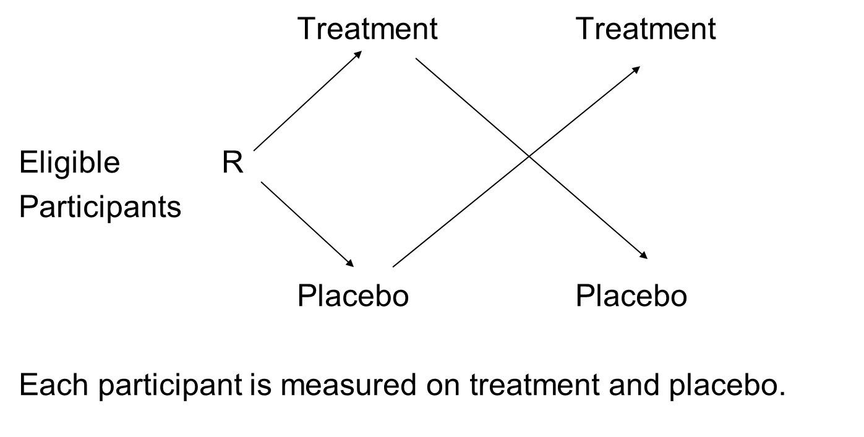
Crossover Trial

Slide 44
Hypothesis Testing for μ_{d}
Continuous outcome
Two matched/paired sample
H₀: μ_{d} = 0
H₁: μ_{d} > 0, μ_{d} < 0, μ_{d} ≠ 0
Test statistic:
n ≥ 30 (Find critical value
in Table 1C,
n < 30 Table 2, df = n – 1)

Slide 45
Example 7.10. Hypothesis Testing for μ_{d} (1 of 3)
Is there a statistically significant difference in mean systolic blood pressures (SBPs) measured at exams 6 and 7 (approximately 4 years apart) in the Framingham Offspring Study?
Among n = 15 randomly selected participants, the mean difference was –5.3 units and the standard deviation was 12.8 units. Differences were computed by subtracting the exam 6 value from the exam 7 value.

Slide 46
Example 7.10. Hypothesis Testing for μ_{d} (2 of 3)
1. H₀: μ_{d} = 0
H₁: μ_{d} ≠ 0 α = 0.05
2. Test statistic:
3. Decision rule: df = n – 1 = 14
Reject H₀ if t ≥ 2.145 or if z ≤ –2.145

Slide 47
Example 7.10. Hypothesis Testing for μ_{d} (3 of 3)
4. Compute test statistic:
5. Conclusion. Do not reject H₀ because –2.145 < –1.60 < 2.145. We do not have statistically significant evidence at α = 0.05 to show that there is a difference in systolic blood pressures over time.

Slide 48
New Scenario
Outcome is dichotomous
Result of surgery (success, failure)
Cancer remission (yes/no)
Two independent study samples
Data
On each participant, identify group and measure outcome (yes/no)

Slide 49
Hypothesis Testing for (p₁ – p₂)
Dichotomous outcome
Two independent samples
H₀: p₁ = p₂
H₁: p₁ >p₂, p₁< p₂, p₁ ≠ p₂
Test statistic:
(Find critical value
in Table 1C)

Slide 50
Example 7.12. Hypothesis Testing for (p₁ – p₂) (1 of 4)
Is the prevalence of CVD different in smokers as compared to nonsmokers in the Framingham Offspring Study?
 | Free of CVD | History of CVD | Total
Nonsmoker | 2757 | 298 | 3055
Current smoker | 663 | 81 | 744
Total | 3420 | 379 | 3799

Slide 51
Example 7.12. Hypothesis Testing for (p₁ – p₂) (2 of 4)
1. H₀: p₁ = p₂
H₁: p₁ ≠ p₂ α = 0.05
2. Test statistic:
3. Decision rule:
Reject H₀ if Z ≤ –1.96 or if Z ≥ 1.96

Slide 52
Example 7.12. Hypothesis Testing for (p₁ – p₂) (3 of 4)
4. Compute test statistic:

Slide 53
Example 7.12. Hypothesis Testing for (p₁ – p₂) (4 of 4)
5. Conclusion. Do not reject H₀ because –1.96 < 0.927 < 1.96. We do not have statistically significant evidence at α = 0.05 to show that there is a difference in prevalence of CVD between smokers and nonsmokers.

Slide 54
Hypothesis Testing for More than Two Means*
Continuous outcome
k independent Samples, k > 2
H₀: μ₁ = μ₂ = μ_{3 …} = μ_{k}
H₁: Means are not all equal
Test statistic:
(Find critical value in Table 4)
*Analysis of variance

Slide 55
Test Statistic: F Statistic
Comparison of two estimates of variability in data
Between treatment variation, is based on the assumption that H₀ is true (i.e., population means are equal).
Within treatment, residual or error variation, is independent of H₀ (i.e., we do not assume that the population means are equal and we treat each sample separately).

Slide 56
F Statistic (1 of 2)
Difference between each group mean and overall mean
Difference between each observation and its group mean (within group variation—error)

Slide 57
F Statistic (2 of 2)
F = MS_{B}/MS_{E}
MS = Mean Square
What values of F indicate H₀ is likely true?

Slide 58
Decision Rule
Reject H₀ if F ≥ critical value of F with df₁ = k – 1 and df₂ = N – k from Table 4
k = Number of comparison groups
N = Total sample size

Slide 59
ANOVA Table
Source of Sums of Mean
Variation Squares df Squares F
Between
treatments k – 1 SSB/k – 1 MSB/MSE
Error N – k SSE/N – k
Total N – 1

Slide 60
Example 7.14. ANOVA (1 of 12)
Is there a significant difference in mean weight loss among four different diet programs? (Data are pounds lost over 8 weeks)
Low-Cal | Low-Fat | Low-Carb | Control
8 | 2 | 3 | 2
9 | 4 | 5 | 2
6 | 3 | 4 | -1
7 | 5 | 2 | 0
3 | 1 | 3 | 3

Slide 61
Example 7.14. ANOVA (2 of 12)
1. H₀: μ₁ = μ₂ = μ₃ = μ₄
H₁: Means are not all equal α = 0.05
2. Test statistic:

Slide 62
Example 7.14. ANOVA (3 of 12)
3. Decision rule:
df₁ = k – 1 = 4 – 1 = 3
df₂ = N – k = 20 – 4 =16
Reject H₀ if F ≥ 3.24

Slide 63
Example 7.14. ANOVA (4 of 12)
Summary Statistics on Weight Loss by Treatment
Low-Cal Low-Fat Low-Carb Control
N 5 5 5 5
Mean 6.6 3.0 3.4 1.2
Overall Mean = 3.6

Slide 64
Example 7.14. ANOVA (5 of 12)
= 5(6.6 – 3.6)² + 5(3.0 – 3.6)² + 5(3.4 – 3.6)² + 5(1.2 – 3.6)²
= 75.8

Slide 65
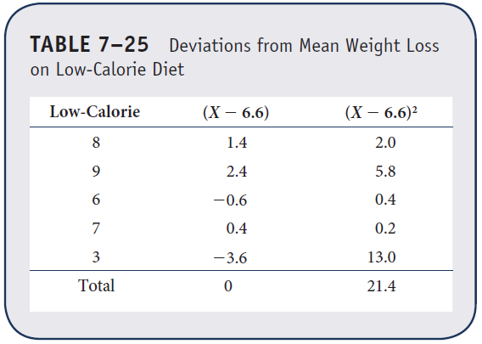
Example 7.14. ANOVA (6 of 12)

Slide 66
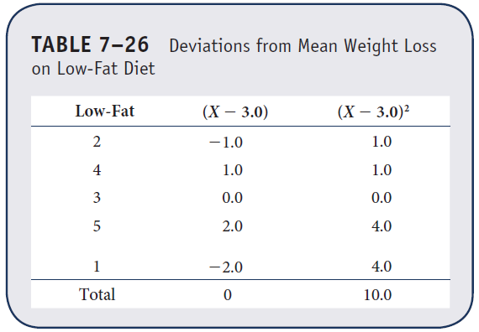
Example 7.14. ANOVA (7 of 12)

Slide 67
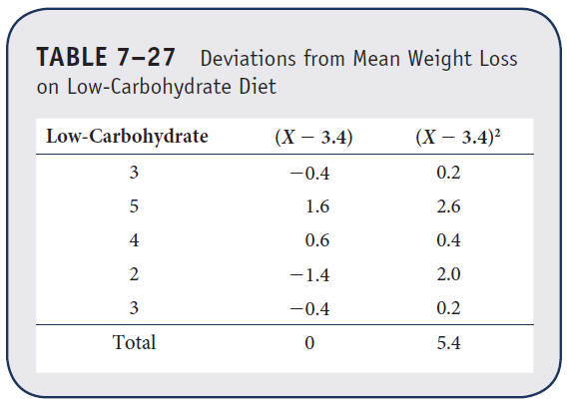
Example 7.14. ANOVA (8 of 12)

Slide 68
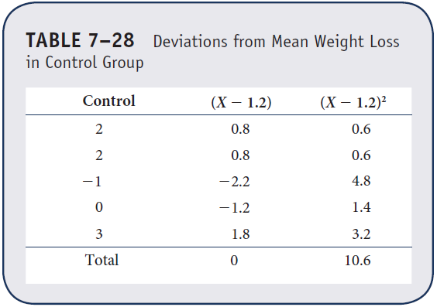
Example 7.14. ANOVA (9 of 12)

Slide 69
Example 7.14. ANOVA (10 of 12)
= 21.4 + 10.0 + 5.4 + 10.6 = 47.4

Slide 70
Example 7.14. ANOVA (11 of 12)
Source of Sums of Mean
Variation Squares df Squares F
Between 75.8 3 25.3 8.43
Treatments
Error 47.4 16 3.0
Total 123.2 19

Slide 71
Example 7.14. ANOVA (12 of 12)
4. Compute test statistic:
F = 8.43
5. Conclusion. Reject H₀ because 8.43 > 3.24. We have statistically significant evidence at α = 0.05 to show that there is a difference in mean weight loss among four different diet programs.

Slide 72
Two-Factor ANOVA
Compare means of a continuous outcome across two grouping variables or factors
Overall test—is there a difference in cell means?
Factor A—marginal means
Factor B—marginal means
Interaction—difference in means across levels of Factor B for each level of Factor A?

Slide 73
Interaction
Cell Means Factor B
1 2 3
Factor A 1 45 58 70
2 65 55 38

Slide 74
No Interaction
Cell Means Factor B
1 2 3
Factor A 1 45 58 70
2 38 55 65

Slide 75
Example 7.16. Two-Factor ANOVA (1 of 3)
Clinical trial to compare time to pain relief of three competing drugs for joint pain. Investigators hypothesize that there may be a differential effect in men versus women.
Design: N = 30 participants (15 men and 15 women) are assigned to three treatments (A, B, C)

Slide 76
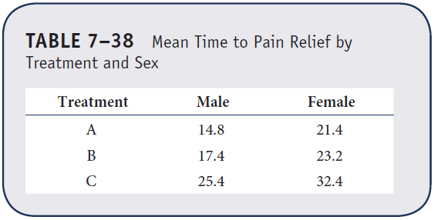
Example 7.16. Two-Factor ANOVA (2 of 3)
Mean times to pain relief by treatment and sex
Is there a difference in mean times to pain relief? Are differences due to treatment? Sex? Or both?

Slide 77
Example 7.16. Two-Factor ANOVA (3 of 3)
Source Sums of Mean
of Variation Squares df Square F p-value
Model 967.0 5 193.4 20.7 0.0001
Treatment 651.5 2 325.7 34.8 0.0001
Sex 313.6 1 313.6 33.5 0.0001
Treatment*Sex 1.9 2 0.9 0.1 0.9054
Error 224.4 24 9.4
Total 1191.4 29

Slide 78
Hypothesis Testing for Categorical or Ordinal Outcomes*
Categorical or ordinal outcome
Two or more samples
H₀: The distribution of the outcome is independent of the groups
H₁: H₀ is false
Test statistic:
(Find critical value in Table 3: df = (r – 1)(c – 1))
* χ² test of independence

Slide 79
Chi-Square Test of Independence
Outcome is categorical or ordinal (2+ levels) and there are two or more independent comparison groups (e.g., treatments).
H₀: Treatment and outcome are independent distributions of outcome are the same across treatments)

Slide 80
Example 7.17. χ² Test of Independence (1 of 6)
Is there a relationship between students’ living arrangement and exercise status?
Exercise Status
None Sporadic Regular Total
Dormitory 32 30 28 90
On-campus apt. 74 64 42 180
Off-campus apt. 110 25 15 150
At home 39 6 5 50
Total 255 125 90 470

Slide 81
Example 7.17. χ² Test of Independence (2 of 6)
1. H₀: Living arrangement and exercise status are
independent
H₁: H₀ is false α = 0.05
2. Test statistic:
3. Decision rule: df = (r – 1)(c – 1) = 3(2) = 6
Reject H₀ if χ² ≥ 12.59

Slide 82
Example 7.17. χ² Test of Independence (3 of 6)
4. Compute test statistic:
O = Observed frequency
E = Expected frequency
E = (row total)*(column total)/N

Slide 83
Example 7.17. χ² Test of Independence (4 of 6)
4. Compute test statistic:
Table entries are Observed (Expected) frequencies
Exercise Status
None Sporadic Regular Total
Dormitory 32 30 28 90
(90*255/470 = 48.8) (23.9) (17.2)
On-campus apt. 74 64 42 180
(97.7) (47.9) (34.5)
Off-campus apt. 110 25 15 150
(81.4) (39.9) (28.7)
At home 39 6 5 50
(27.1) (13.3) (9.6)
Total 255 125 90 470

Slide 84
Example 7.17. χ² Test of Independence (5 of 6)
4. Compute test statistic:

Slide 85
Example 7.17. χ² Test of Independence (6 of 6)
5. Conclusion. Reject H₀ because 60.5 > 12.59. We have statistically significant evidence at α = 0.05 to show that living arrangement and exercise status are not independent. (P < 0.005)

